Slide 1


www.allnyx.com

Slide 2


all about Electronics
Design Development Manufacturing
www.allnyx.com

Slide 3




Our Vision
to become a global leader in electronics manufacturing, design and engineering by catering diverse customer requirements and to create world class integrated facility giving one stop shop experience to customers
Our Mission
to help customers through continuous improvements in quality systems & manufacturing processes to deliver quality products, solutions and services to help them to achieve their goals
www.allnyx.com

Slide 4

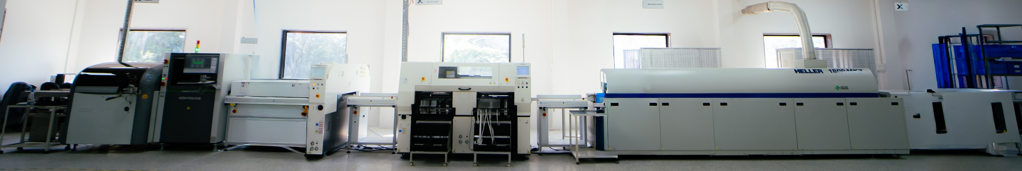
About Us
Lakshya Group of Company
Founded in 2015 at Dabhasa, Vadodara (Guj) India
EMS Revenue Segment : 50% Job-work + 50% Turnkey
Team size : 40
No. of SMT Line : 01 (adding 02nd Line by June 27’)
No. of THT Line : 02
Title 1
www.allnyx.com

Slide 5


Achievements
4000⁺
EMS/CEM
Projects
250⁺
Satisfied
Clients
1 to 7
Days
Quote
3 to 7
Days
Prototype
www.allnyx.com

Slide 6

Production CAPACITY
* per shift
2K⁺
Boards*
per day
60K⁺
Boards*
per month
7L⁺
Boards*
per year
www.allnyx.com

Slide 7

INDUSTRY We Serve
Telecom,
Security & IT
Industrial Automation
17%
34%
High Mix
Low Volume
Healthcare MedTech
Tracking, IoT & Sensor Devices
09%
23%
High Volume
Low Mix
Power & Energy
13%
04%
Automotive
www.allnyx.com

Slide 8

SERVICES We Offer
Design & Engineering**
Rapid Prototype & Pilot Projects
OEM/ODM and Box-Build Solutions
Value Engineering
EMS / Contract Electronics Manufacturing : Job-work & Turnkey
Supply Chain Management (Components)
Electro-Mechanical**
Assembling, Testing & Packing
** Outsourced
www.allnyx.com

Slide 9
Our EXPERTISE
Surface Mount (SMT) and Through Hole (THT) PCB Assembly
PBGA (Pitch Ball Grid Array) & FBGA (Fine Ball Grid Array)
Micro-BGA, CSP, Ultra-fine pitch QFP and QFN
Fine Pitch (0201 and 01005) Components
Manual - Conformal Coating & EPOXY Potting
Components, Parts and Sub-Assemblies
Board Level and System Level Testing
Lead-Free, RoHS Compliant and Non-RoHS Manufacturing
Title 1
www.allnyx.com

Slide 10



What Customer Can EXPECT from Us
Business Ethics, Integrity & Transparency
Extended EMS & Engineering Support
Committed On Time Delivery
Works in Eco systems → Supplier Allnyx Customer
Integrated CEM / EMS Solutions at One Stop
SPOC (Single Point of Contact)
MNC Quality @ Indian Price
Readiness to Invest in tools / equipment
required to cater the need of projects
www.allnyx.com

Slide 11


Infrastructure & Equipment
Title 1

Slide 12

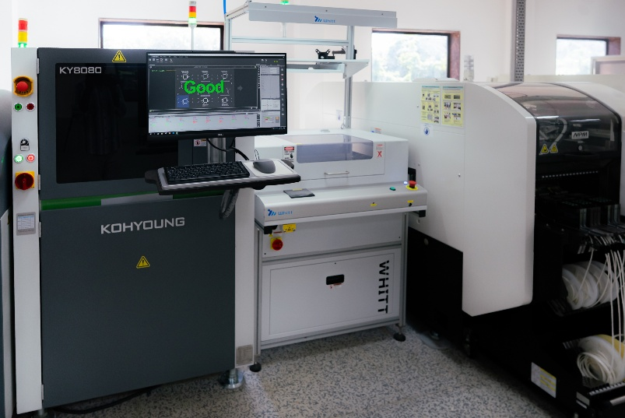
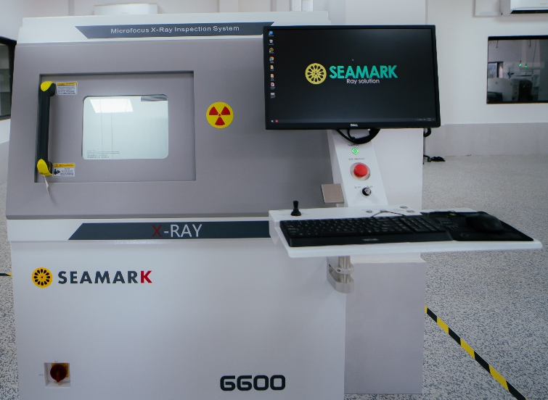
Infrastructure
Allnyx is an eminent Electronics Manufacturing Solution (EMS) providing company with SMT and THT lines.
Title 1
www.allnyx.com

Slide 13
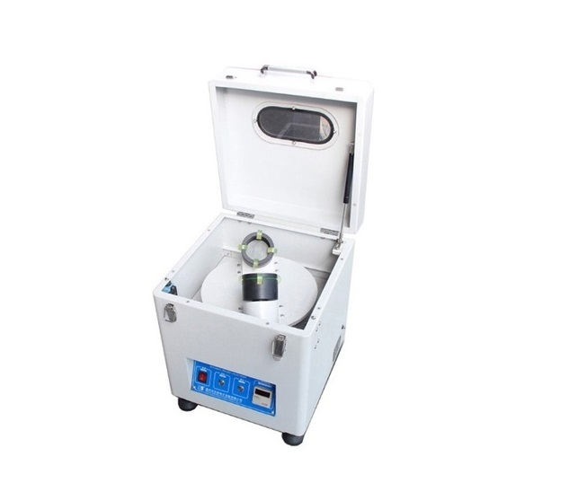
Infrastructure - PASTE Mixer
Adjustable Timer
RoHS and Non-RoHS Paste
Motor Speed: 1350 rpm (max)
Paste Mixer
Ob-m628, china
www.allnyx.com

Slide 14
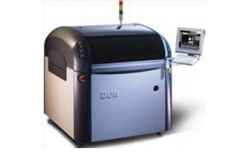
Infrastructure - PRINTER
  Process alignment capability
  2 Cpk @ ± 20µm 6-Sigma
  Machine alignment capability
  2 Cpk @ ± 12.5µm 6-Sigma
  Board Size: 510mm*510mm
  Cycle Time: 9Sec/Board
  Built-in Stencil Cleaning Functionality
STENCIL PRINTER
HORIZON 03IX, DEK
USA

Slide 15
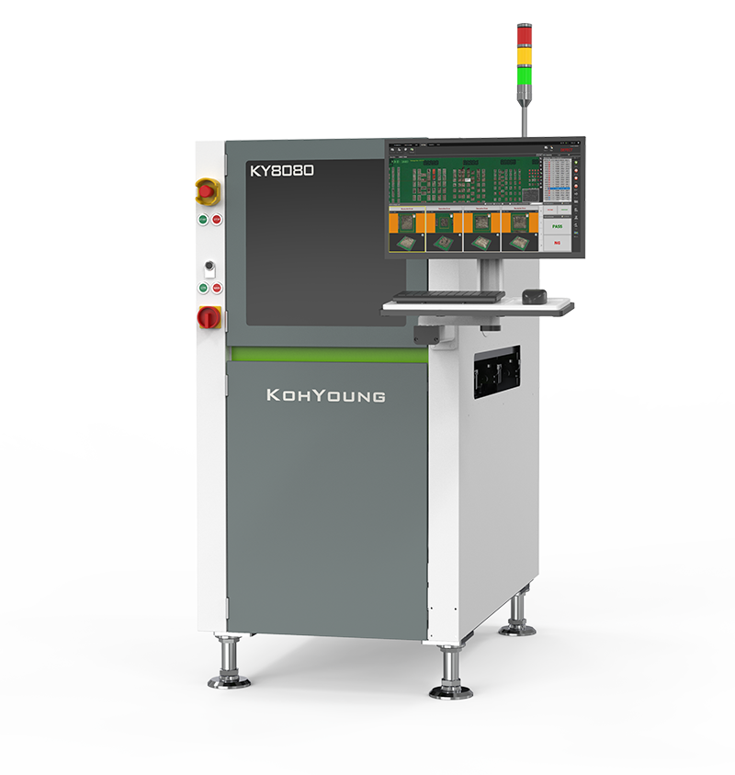
Infrastructure - SPI
  3D Solder Paste Inspection Machine
  True 3D Volume Measurement
  High Accuracy and Repeatability
  Solder Paste Printing Optimization
  Histograms, X-bar & R-Chart, X-bar & S-chart, Cp & Cpk, and % of Gage R&R
  Real-time Data Visualization
  Warp Compensation Technology
  Real-time, Automatic Pad-Reference Teaching
Solder Paste Inspection
KY 8080
Koh young - KOREA

Slide 16
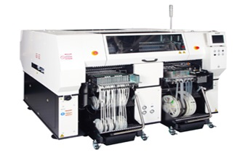
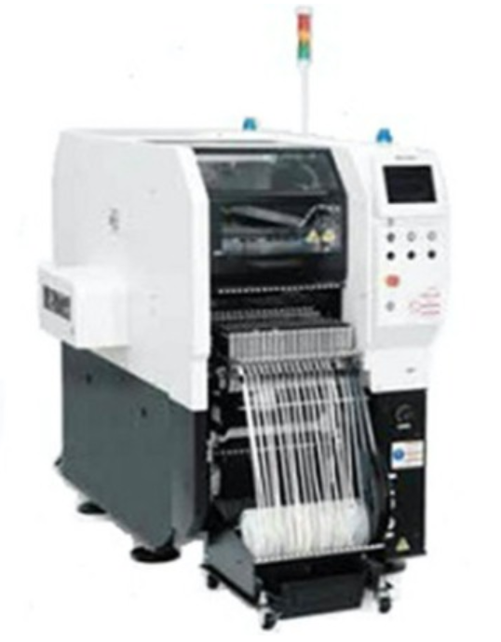
Infrastructure - Pick-n-Place
  120 + 68 Feeders
  Automatic 20 Tray Changer
  Placement Accuracy: ±30 micron Cpk ≥1.0
  Part Handling: 01005 to 120x90mm
  Intelligent Tape feeders & Stick Feeders
  Board Size: 510mm to 490mm
  Combined Rated Speed: 120,000 cph
  PanaCim Software for component traceability
PNP Machine
AM100 + D3A
Panasonic
JAPAN

Slide 17
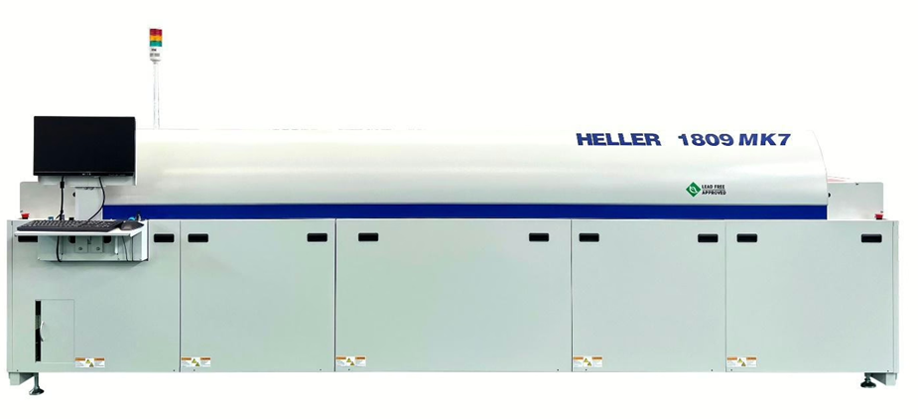
Infrastructure - Reflow OVEN
9 Top and 9 Bottom Heating Zones
2 Cooling Zones
Efficient Heat transfer
Advanced 7 Thermocouple PCB profiling
(KIC make)
REFLOW OVEN
1809 MK7, HELLER
USA

Slide 18
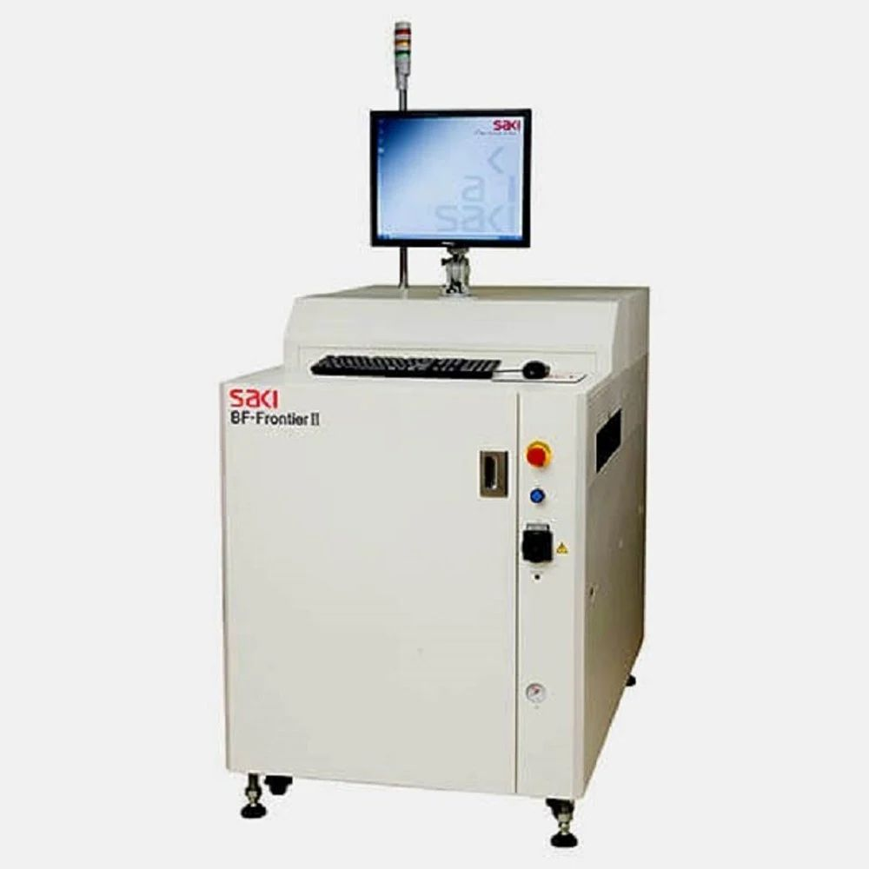
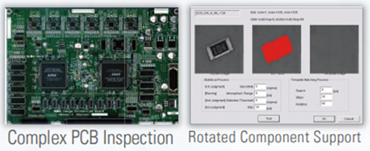
Infrastructure - AOI
High-Speed, High-Precision 2D Visual Inspection
Multiple Inspection Process Support (SMT & THT)
Full-Board Imaging for High Speed Inspection
Simultaneous Double-Sided Scanning
M2M Integration Capabilities with PnP Machine
Offline Debugging
Feedback from AOI to Surface Mount Machine
Auto Optical Inspection
FRONTIER
SAKI - JAPAN
www.allnyx.com

Slide 19
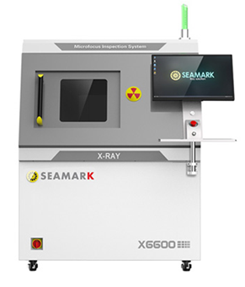
Infrastructure - X Ray
A high-resolution design can obtain the best
image in a very short time for components like
BGA, FBGA, QFN, LGA
Infrared automatic navigation and positioning,
quickly select the shooting location
CNC detection mode, fast automatic
detection for multi-point array
Oblique multi-angle inspection makes it
easier to detect sample defects
The X-ray tube and FDP can be rotated
at the same time (0-60°), making the
detection image more clear and intuitive
2.5D X-Ray Machine
X6600
SEAMARK - CHINA
www.allnyx.com

Slide 20
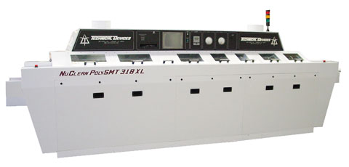
Infrastructure - PCB Cleaning
Contain High Efficiency Blowers
Hybrid Power Option
Quick Disconnect Spray Bars
Chemistry Isolation
Touch Screen Control System
Consta-Temp VFD system
PCB Cleaning Machine
PolySMT 318, Nu Clean
USA
www.allnyx.com

Slide 21
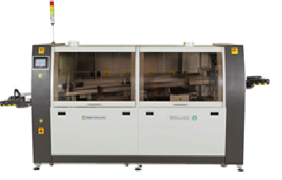
Infrastructure - WAVE
Spray Fluxer with Air Knife
2 Pre-heating Zones
Dual Jet Wave
Dedicated Solder Baths for Lead-Free and Leaded Assembly
WAVE SOLDERING MACHINE
STALLION 321FC JW, EMST INDIA
www.allnyx.com

Slide 22
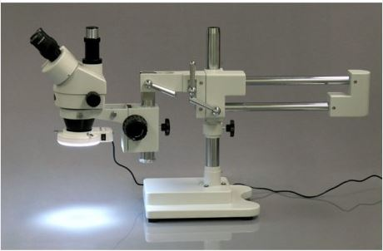
Infrastructure - SCOPE
3.5X-90X Large Zoom Power Microscope on Boom with 54-LED Ring Light
45 degree Inclined Trinocular Head
SUPER Widefield High-Eyepoint Eyepieces
Adjustable Interpupillary Distance
Microscope
MU500, amscope
USA
www.allnyx.com

Slide 23
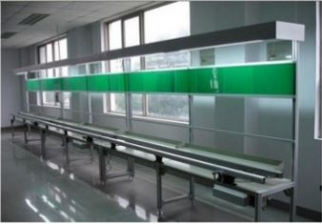
Infrastructure - INSERTION Line
Insert 15-20 types of components @ a time
PCB size: 50mmX50mm to 250mmX600mm
ESD Safe assembly Line
MANUAL INSERTION LINE DELHI, INDIA
www.allnyx.com

Slide 24








Certification & Compliances
In Process for following Certification

Slide 25

SMT Capabilities
Screen Printing with 3D Paste Inspection
State of the Art, High-Speed placement capabilities
Separate Processes for RoHS / REACH and Leaded Assembly
Placement of BGA, µBGA, QFN, 01005 & 0201
RoHS Complied Reflow Ovens, Multi-Zones Reflow
Machine Placement Capacity = 120K Chips/Hour
Placement Accuracy = 30 Microns
www.allnyx.com

Slide 26
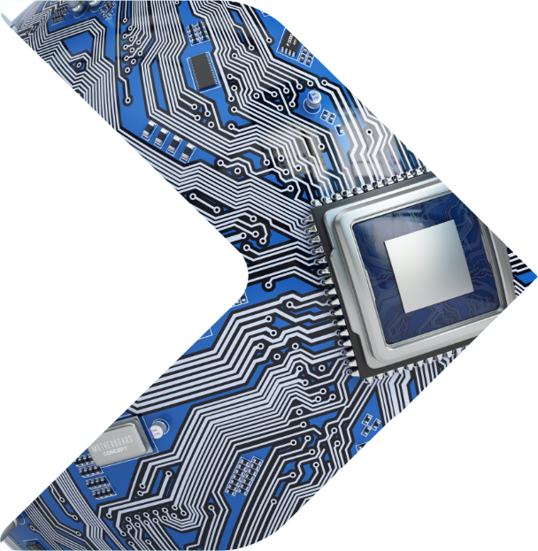
BGA Capabilities
30 Micron Placement Accuracy
Expert BGA Reballing
Micro-BGA (High pin count)
BGA Level Measurement via X-Ray
Any size/package BGA
www.allnyx.com

Slide 27


THT Capabilities
Advanced Technology Wave Solder (RoHS, Non-RoHS)
Skilled Manual Soldering
Leaded / Lead-free Soldering
Manual Insertion Line
www.allnyx.com

Slide 28

TESTING Capabilities
Full Product Testing
Functional Testing
In-Circuit Testing (ICT)*
Flying Probe Testing*
Customized Testing
* outsourced on demand
www.allnyx.com

Slide 29





NPI (3-7 Days)
Product Application & Design Documents
Box-Build (3-5 Days)
Production Data - BoM, Gerber data
Testing Procedure, 3D data of box fixture
Turnkey (1-3 Days)
Production Data - BoM, Gerber data
Proto / Job-work (1-2 Days)
Production Data - BoM, Gerber data
.
www.allnyx.com

Slide 30
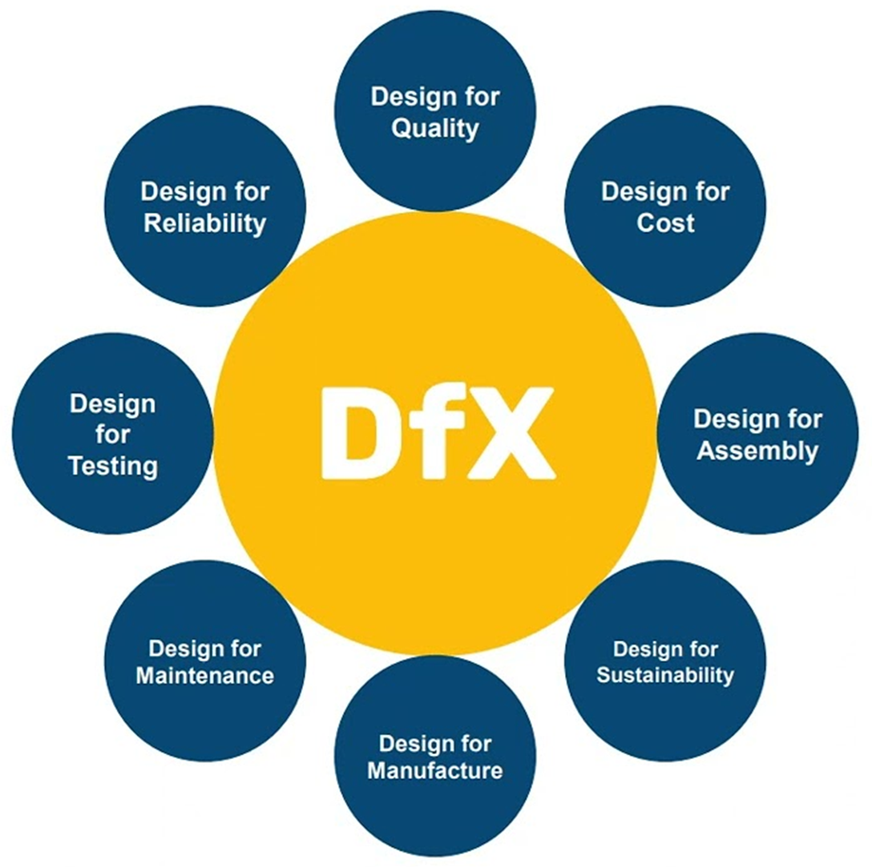
DfX Analysis
DFM/DFMA to Optimize:
Product & Design Reliability
Mechanical Part consolidation
Manufacturability as per IPC
BOM Cost and Availability
EoL/Obsolescence Planning
www.allnyx.com

Slide 31
RAPID
Prototype
Title 1
www.allnyx.com

Slide 32

RAPID Prototype
Quick Turn PCB Fabrication
Component Kit Sourcing
Strategic AVL (Approved Vendor List) & Parts Management
Quick Turn PCB Assembly
Plastic Parts Proto by SLS, SLA, FDM, CNC
3D Printing & Metal Parts Fabrication
FMEA (Failure Mode Effect Analysis) and DFx Reports
Product Assembly & Test Development
Analysis and Review Reports for
Design Refinement
www.allnyx.com

Slide 33
VALUE Engineering
BoM Analysis & BoM Cost Reduction
Cost Optimization through Alternate Vendor,
Component / Material Selection and Sourcing
Metal Enclosure to Plastic Conversion
Through Hole to SMT PCB Conversion
Alternate Design / Design Modifications
Component Obsolescence Resolution
Complete Product Revamping
Enhance Product Features, Performance & Quality
www.allnyx.com

Slide 34

SUPPLY CHAIN Management
Production, Raw Materials Planning, Forecasting & Ordering
Delivery Acknowledgment, Planning and Traceability
Lead Time Reduction through Vendor Process Analysis
Vendor Development & Vendor Managed Inventory
Quality Improvement through Process Refinement
Cost Reduction through Negotiation, Alternate Part and Shipment Consolidation
Supply Chain Risk Analysis
Small Batch Procurement and Production for Prototypes and Pilot Run
www.allnyx.com

Slide 35
Thank You
Allnyx Technologies LLP
Info@allnyx.com | www.allnyx.com
Contact :- +91 63570 10210

